Slide 1
BACHELOR OF FINANCIAL ENGINEERING 4.1 Jan-Apr 2022
STA 2421: DERIVATIVE SECURITIES

Slide 2
Equity Forward Contracts With Continuous Dividends
To calculate the price of an equity index forward contract, rather than take the present value of each dividend on (possibly) hundreds of stocks, we can make the times) at the dividend yield rate on the index. Using continuous time discounting, we can calculate the no arbitrage forward price as:

Slide 3
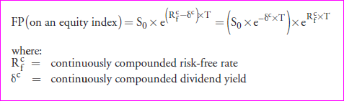
Equity Forward Contracts With Continuous Dividends
The relationship between the discrete risk-free rate Rf and the continuously compounded rate Rf c is R ln 1+ R f c = ( f ). For example, 5% compounded annually is equal to ln(1.05) = 0.04879 = 4.879% compounded continuously. The 2-year 5% future value factor can then be calculated as either 1.052 = 1.1025 or e^{0.04879×2} = 1.1025.

Slide 4
Equity Forward Contracts With Continuous Dividends
Example:
Calculating the price of a forward contract on an equity index The value of the S&P 500 index is 1,140. The continuously compounded risk-free rate is 4.6% and the continuous dividend yield is 2.1%.
Calculate the no-arbitrage price of a 140-day forward contract on the index.

Slide 5

Equity Forward Contracts With Continuous Dividends
For the continuous time case, the value of the forward contract on an equity index is calculated as follows:

Slide 6
Equity Forward Contracts With Continuous Dividends
Example: Calculating the value of a forward contract on an equity index
After 95 days, the value of the index in the previous example is 1,025.
Calculate the value to the long position of the forward contract on the index, assuming the continuously compounded risk-free rate is 4.6% and the continuous dividend yield is 2.1%.

Slide 7
Equity Forward Contracts
Calculate and interpret the price and the value of
a forward contract on a fixed-income security,
a forward rate agreement (FRA), and
a forward contract on a currency.

Slide 8
Calculating the Price of a Forward on a Fixed Income Security
In order to calculate the no-arbitrage forward price on a coupon-paying bond, we can use the same formula as we used for a dividend-paying stock or portfolio, simply substituting the present value of the expected coupon payments (PVC ) over the life of the contract for PVD, or the future value of the coupon payments (FVC ) for FVD, to get the following formulas: {NEXT SLIDE}
In our examples, we assume that the spot price on the underlying coupon-paying bond includes accrued interest. For fixed income contracts, use a 365-day basis to calculate T if the contract maturity is given in days.

Slide 9
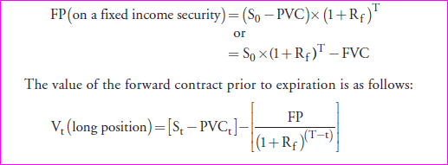
Calculating the Price of a Forward on a Fixed Income Security
.

Slide 10
Calculating the Price of a Forward on a Fixed Income Security
Example: Calculating the price of a forward on a fixed income security
Calculate the price of a 250-day forward contract on a 7% U.S. Treasury bond with a spot price of $1,050 (including accrued interest) that has just paid a coupon and will make another coupon payment in 182 days. The annual risk-free rate is 6%.
Note: U.S. Treasury bonds make semiannual coupon payments

Slide 11
Calculating the Price of a Forward on a Fixed Income Security
Example 1: Calculating the price of a forward on a fixed income security
Calculate the price of a 250-day forward contract on a 7% U.S. Treasury bond with a spot price of $1,050 (including accrued interest) that has just paid a coupon and will make another coupon payment in 182 days. The annual risk-free rate is 6%.
Note: U.S. Treasury bonds make semiannual coupon payments

Slide 12
Calculating the Price of a Forward on a Fixed Income Security
Example 2: Calculating the value of a forward on a fixed income security
After 100 days, the value of the bond in the previous example is $1,090. Calculate the value of the forward contract on the bond to the long position, assuming the risk-free rate is 6.0%.

Slide 13
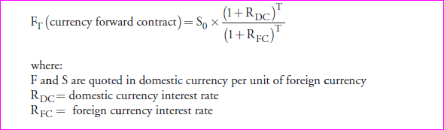
Pricing Currency Forward Contracts
The calculation of the currency forward rate is an application of covered interest parity. Covered interest rate parity gives us the no-arbitrage forward price of a unit of foreign currency in terms of the home currency for a currency forward contract of length T in years:(For foreign currency contracts use a 365-day basis to calculate T if the maturity is given in days.)

Slide 14
Pricing Currency Forward Contracts
Example 1: Calculating the price of a currency forward contract
The risk-free rates are 6% in the United States and 8% in Mexico. The current spot exchange rate is $0.0845 per Mexican peso (MXN).
Calculate the forward exchange rate for a 180-day forward contract.

Slide 15
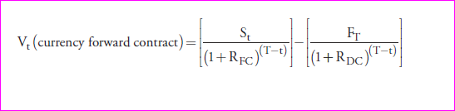
Valuing Currency Forward Contracts
At any time prior to maturity, the value of a currency forward contract to the long will depend on the spot rate at time t, S_{t}, and can be calculated as:

Slide 16
Valuing Currency Forward Contracts
Example: Calculating the value of a currency forward contract
Calculate the value of the forward contract in the previous example if, after 15 days, the spot rate is $0.0980 per MXN.

Slide 17
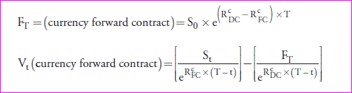
Valuing Currency Forward Contracts
The continuous time price and value formulas for currency forward contracts are:
V_{t} in both cases is the value in domestic currency units for a contract covering one unit of the foreign currency. For the settlement payment in the home currency on a contract, simply multiply this amount by the notional amount of the foreign currency covered in the contract.

